Slide 1
Quiz Game System
PBL Course Name: Object Oriented Programming through C++
N.AKHILA, M.Tech (Ph.D),
ASSISTANT PROFESSOR,
AIML DEPTARTMENT
Course Instructor:
Presented by:
25B11AI871 | PADIMI MOKSHAGNA
26B21AI037 | ALLADA RAM CHARAN TEJA
25B11AIC29 | VANAMADI RAMA VENKATA PAVAN
26B21AI764 | MUDAVATHU MAHESH

Slide 2
Contents
C++ Concepts Used
Inputs
Expected Outputs
Flowchart
Team Contribution
Conclusion
References
Abstract
Introduction
Problem Statement
Objectives
Novelty of the Project
Modules and Functions
Implementation

Slide 3
Project Abstract
The Quiz Game System is a simple C++ application designed to conduct quizzes efficiently.
Allows users to enter their name.
Provides different quiz topics.
Displays multiple-choice questions with four options.
Automatically checks the selected answers.
Calculates the score, percentage and grade.
Provides immediate quiz results.
Uses file handling to store and manage quiz questions.

Slide 4
Project Abstract
Introduction
Project Abstract
Project Abstract
Quizzes are commonly used to test knowledge and understanding.
Manual quiz evaluation can take more time and effort.
A computerized quiz system can automate question display and answer evaluation.
This project provides a simple menu-driven C++ application.
Users can select a topic and answer multiple-choice questions.
The system demonstrates practical use of Object-Oriented Programming concepts.

Slide 5
Problem Statement & Objectives
Problem Statement
  Traditional quizzes often require manual question management, answer checking, and score calculation. This can be time-consuming and may lead to errors in evaluation. A simple computerized quiz system can automate these tasks and provide instant results.
  Objectives
Develop an interactive quiz application using C++.
Allow users to select different quiz topics.
Display multiple-choice questions with four options.
Automatically check answers and calculate scores.
Display percentage, grade, and performance.
Provide a simple and user-friendly console interface.

Slide 6
Novelty Of The Project
Simple and easy-to-use menu-driven interface.
Questions are stored separately in a CSV question bank.
New questions can be added without modifying the main C++ program.
Users can select the quiz topic before starting.
Answers are automatically validated.
Score, percentage and grade are calculated instantly.
Invalid answer choices are handled through input validation.
Users can play the quiz again with another topic.

Slide 7
Planned Modules / Functions
Player Module
getPlayerName()
Accepts and manages the player's name.
Topic Selection Module
selectTopic()
Allows the user to select a quiz topic.
Question Bank Module
loadQuestions()
Reads questions from the CSV file.
Quiz Module
startQuiz()
Displays questions and accepts answers.
Answer Evaluation Module
Checks the selected answer.
Updates the score.
Result Module
Calculates percentage.
Assigns grade.
Displays final performance.
File Handling Module
Reads quiz questions from the CSV file.

Slide 8
Implementation
Developed using C++.
Uses a Question structure to store question details.
Questions are stored in an external CSV file.
ifstream is used to read the question file.
stringstream is used to process each question record.
vector stores multiple question objects.
A menu-driven main() function controls the system.
Input validation is used for topic and answer selection.
The quiz calculates score and percentage automatically.
Question Data
Each question contains:
Topic
Question text
Option 1
Option 2
Option 3
Option 4
Correct answer

Slide 9
C++ Concepts used
Structures / Classes – Represent and organize question data.
Objects / Data Structures – Store individual quiz questions.
Functions – Divide the program into manageable modules.
Vectors – Store multiple questions.
Strings – Store topics, questions and options.
File Handling – Read questions from the CSV file.
Conditional Statements – Check answers and calculate grades.
Loops – Process multiple questions and quiz attempts.
Input Validation – Prevent invalid menu and answer choices.
OOP Concepts – Used to organize the quiz system into reusable components.

Slide 10
INPUTS
Question Bank Input
Player name
Quiz topic
Questions are read from the CSV file containing:
Topic
Question
Four options
Correct answer
C++
General Knowledge
Science
Mathematics
Answer choice: 1, 2, 3 or 4
Replay choice: Y / N

Slide 11
EXPECTED OUTPUTS
Welcome message for the player.
Selected quiz topic.
Multiple-choice questions with four options.
Correct / Wrong answer message.
Correct answer for an incorrect response.
Final score.
Percentage.
Grade.
Performance summary.
Option to play another quiz.
Validation messages for invalid inputs.

Slide 12
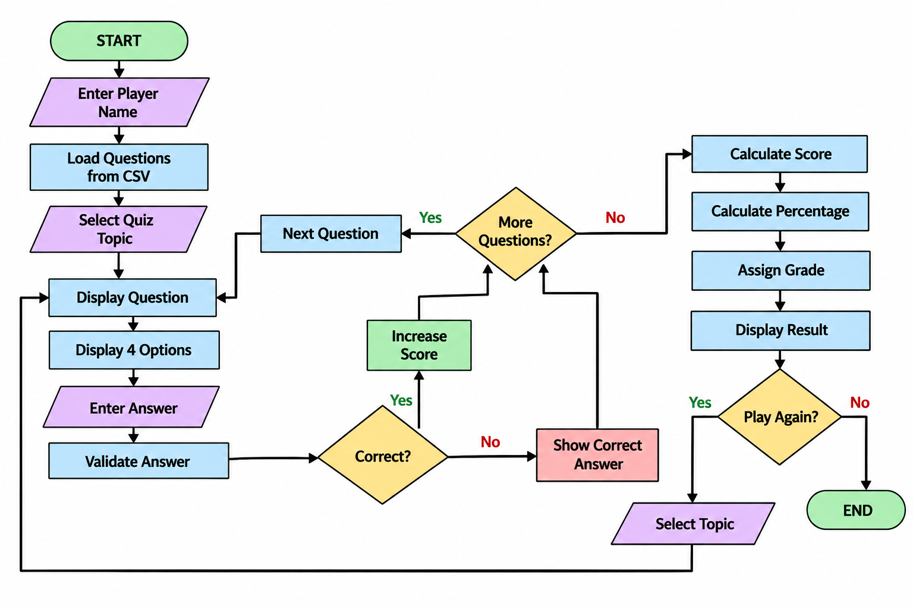
FLOWCHART

Slide 13
ER Diagram / DFD
topic
question_id
quiz_id
difficulty
player_id
Player_name
Option_a
Option_b
Option_c
Option_d
Question text
Correct answer
PLAYER
M
ATTEMPTS
N
QUIZ
N
CONTAINS
1
QUESTION
N
GENRATES
Resullt_ID
Quiz_id(FK)
Player_ID(FK)
Attempt date
Resullt_ID
Resullt_ID
Quiz_id(FK)
Quiz_id(FK)
1
grade
Score
RESULT
Score
Percentage

Slide 14
Role of Each Individual
Roll No. | Name | Role / Responsibility
25B11AI871 | Padimi Mokshagna | Project planning, system design and C++ coding
26B11AI037 | Allada Ram Charan Teja | Question bank and quiz module development
25B11AIC29 | Vanamadi_Rama Venkata Pavan | Score calculation, result generation and testing
25B11AI764 | Mudavathu_Mahesh | File handling, documentation and presentation

Slide 15
CONCLUSION
The Quiz Game System simplifies the process of conducting quizzes.
It reduces manual answer checking and score calculation.
Users can select different topics and attempt multiple-choice questions.
The system automatically calculates score, percentage and grade.
External CSV storage makes the question bank easy to manage.
The project demonstrates practical implementation of C++ programming concepts.
It can be further extended with database connectivity, user login and a graphical interface.

Slide 16
References
C++ programming concepts and Object-Oriented Programming course material.
C++ Standard Library documentation.
C++ file handling and stream concepts.
Structures, functions, vectors and strings in C++.
CSV file handling concepts.
Project source code and implementation developed for the PBL project.

Slide 17


